Slide 1
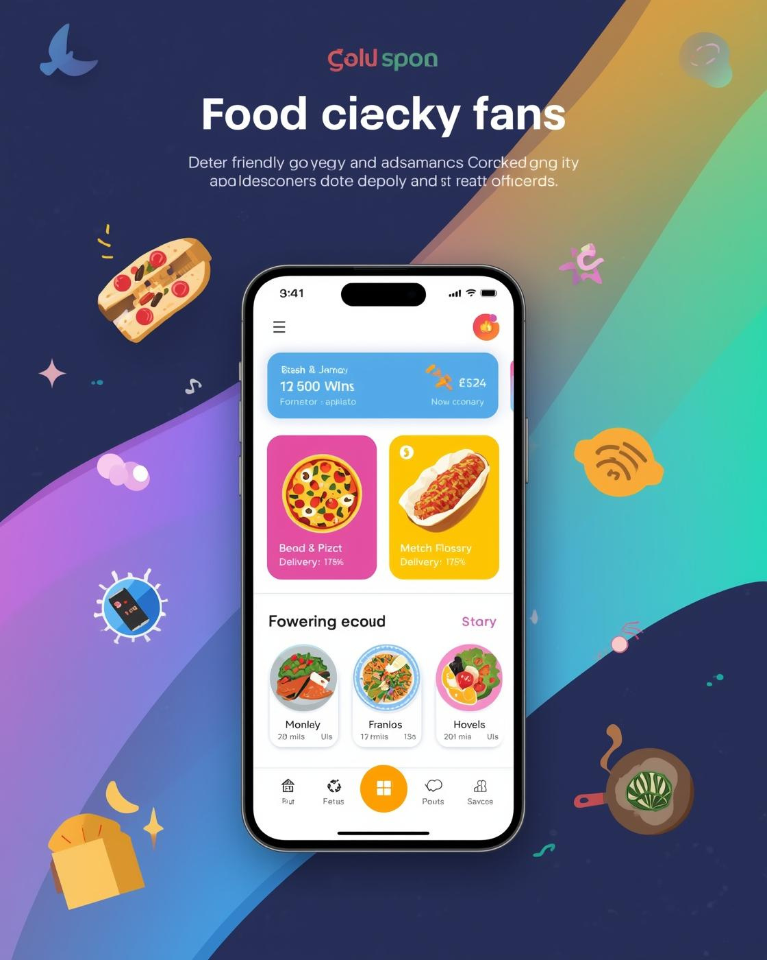
Welcome to PORTKEY
Food Delivery System
Presented by the PORTKEY Team

Slide 2

Current Delivery Challenges
Difficulty in Ordering and Tracking
Many users face challenges with manual ordering, limited payment options, and a lack of tracking capabilities, leading to frustration and dissatisfaction with current food delivery systems.
CHALLENGES IN DELIVERY
2

Slide 3
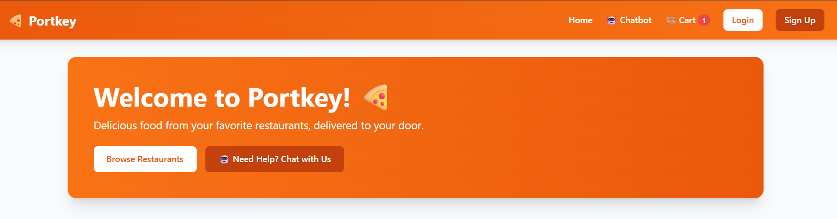
PORTKEY Overview
Your Connection to Local Flavors
PORTKEY connects you to local restaurants for a seamless food delivery experience, featuring an intuitive interface, secure payments, and AI support, all tailored for your convenience and satisfaction.
NOTES ON FEATURES
3

Slide 4
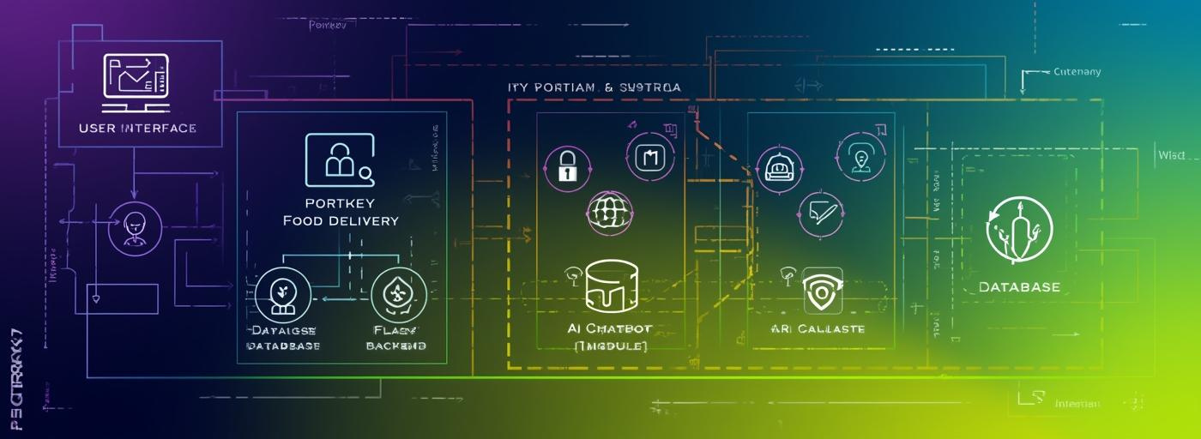
System Design Overview
Explore the architecture and technology stack utilized.
NOTES ON ARCHITECTURE
4

Slide 5

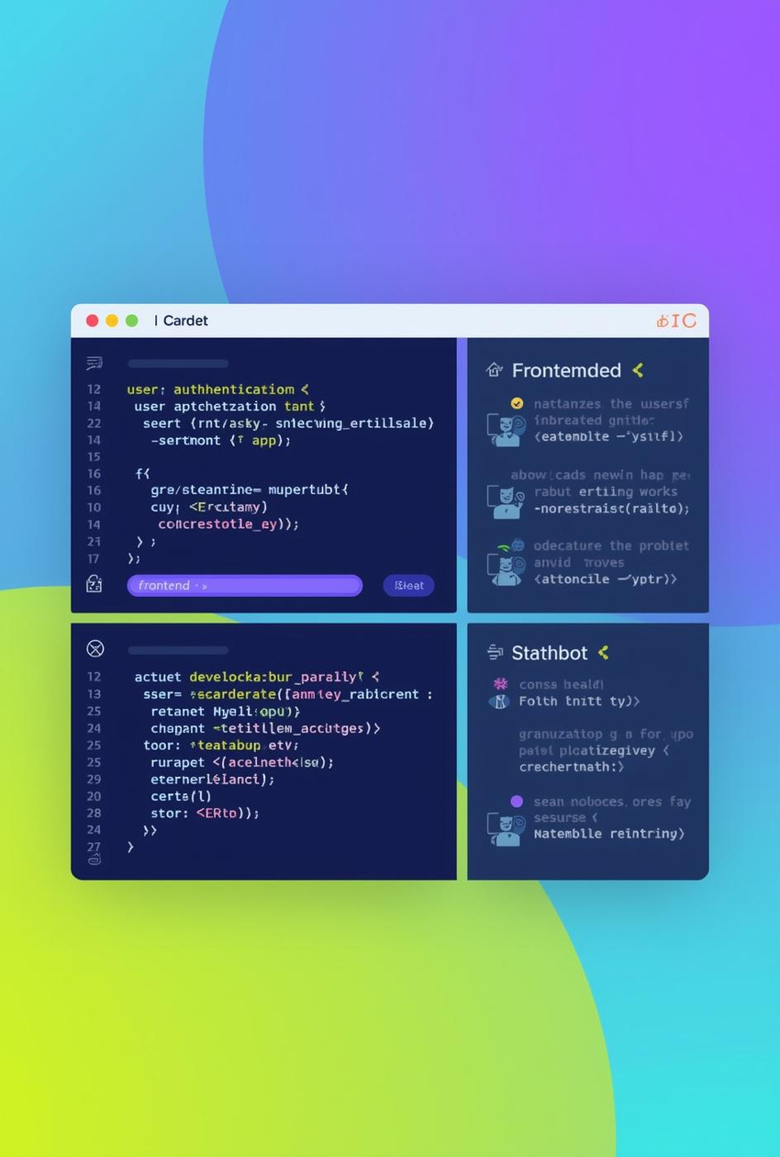
Technology Stack
Frontend and Backend Overview
SYSTEM OVERVIEW
5

Slide 6
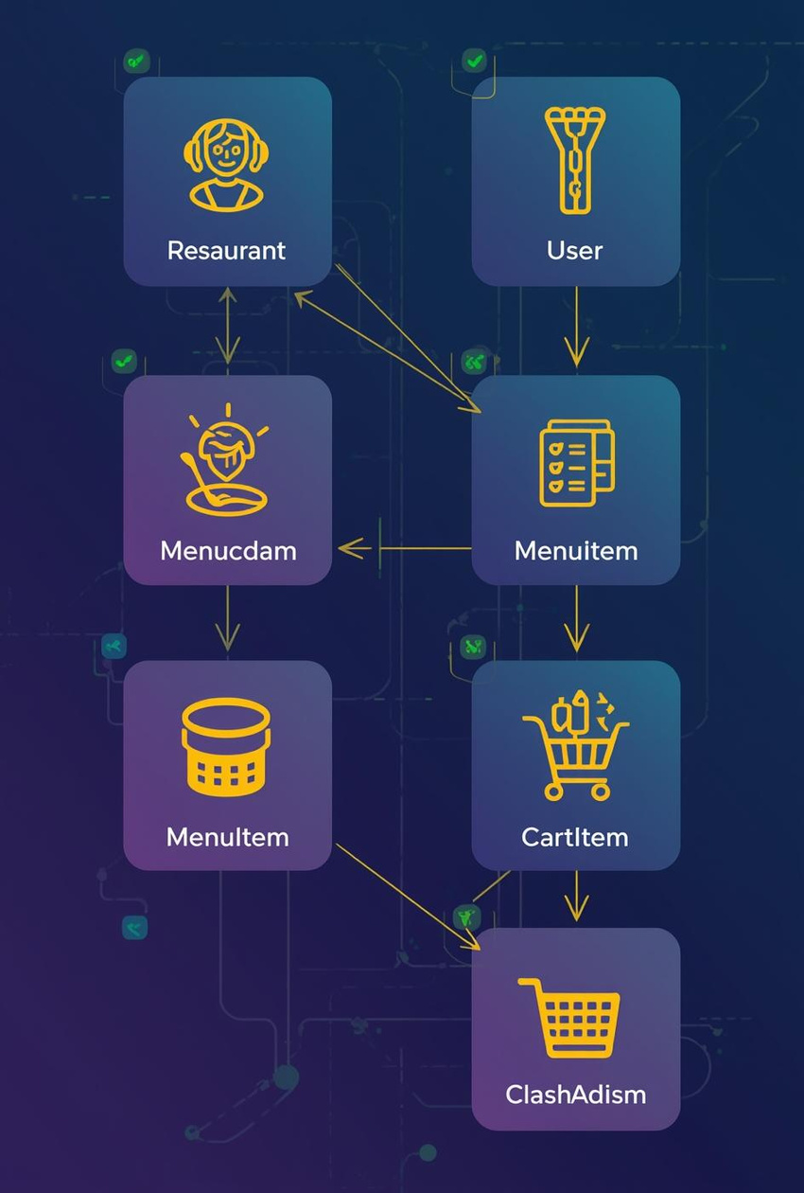

Database Models
Overview of Key Application Entities
NOTES ON RELATIONSHIPS
6

Slide 7
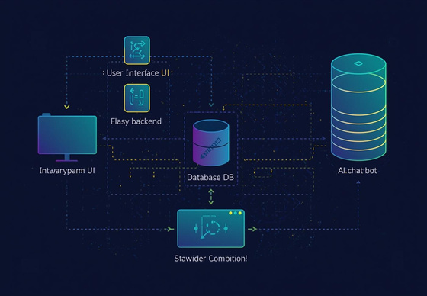
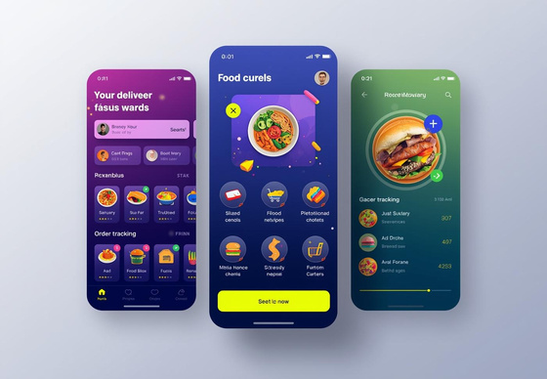
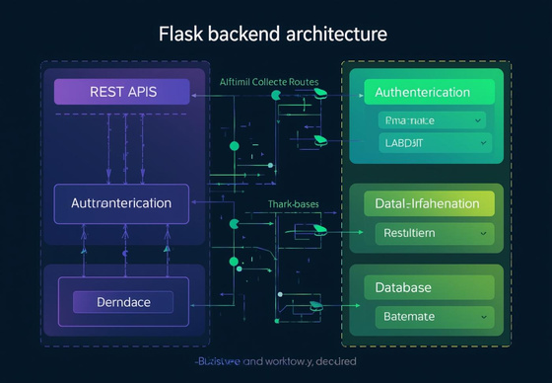
System Architecture
User Interface
The UI serves as the primary interaction point, allowing users to browse, select, and order food efficiently.
Overview of Components
Flask Backend
The Flask backend processes user requests, ensuring smooth operation and managing interactions with the database and AI features.
Database Management
The database framework supports structured data storage, enabling reliable information retrieval for users and restaurants alike.
ADDITIONAL INSIGHTS
7

Slide 8

Core Features Overview
Highlighting AI chatbot and user management functionalities
NOTES ON FUNCTIONALITY
8

Slide 9
User Management Features
Registration
The system allows users to easily register using email, ensuring a secure and straightforward onboarding process while capturing essential user information for personalized experiences.
Authentication
Robust authentication mechanisms prevent unauthorized access, protecting user data through secure login processes, including multi-factor authentication options to enhance overall security.
Profile Management
Users can seamlessly manage their profiles, update personal details, and customize preferences, ensuring a tailored experience that meets their unique ordering needs and preferences.
Security Measures
Implementing strong security protocols, including encryption and data protection strategies, ensures user information remains confidential and secure while maintaining compliance with industry standards.
ADDITIONAL INSIGHTS
9

Slide 10
Restaurant Browsing Ideas
Search
Users can easily search for restaurants by name, cuisine type, or location, enhancing their experience and allowing for quick and efficient discovery of dining options available in their area.
Filtering
The filtering feature enables users to narrow down their choices based on preferences such as ratings, price range, or dietary options, making it easier to find suitable eateries that meet their needs.
Detailed Information
Each restaurant listing provides detailed information, including menus, reviews, photos, and contact information, to help users make informed choices about where to order their next meal effectively.
Recommendations
Personalized recommendations are generated based on user preferences and past orders, ensuring a more tailored experience that encourages exploration of new restaurants and cuisines within the platform.
NOTES & INSIGHTS
10

Slide 11
Order Management Features
Cart
The cart feature allows users to add selected items, view their total, and modify quantities. This intuitive interface enhances user experience during their ordering process and supports seamless navigation.
Stock Validation
Stock validation ensures that only available items can be added to the cart. This prevents order errors and enhances customer satisfaction by maintaining accurate inventory levels throughout the ordering process.
Price Calculation
The system automatically calculates the total price based on selected items, including taxes and discounts. This feature provides users with transparent pricing, avoiding surprises at checkout and improving overall trust.
Order Placement
Users can confirm their orders with a simple click. This process includes payment options and order summaries, making it efficient and user-friendly while ensuring a secure transition to completion.
KEY FEATURES OVERVIEW
11

Slide 12

Delivery Area Overview
Highlighting service locations in Manipal and Mangalore
NOTES ON COVERAGE
12

Slide 13
Coverage & Workflow
Restaurants
PORTKEY connects users to 10 local restaurants in Manipal and Mangalore, providing diverse culinary options. Diners can explore various cuisines and special dishes from their favorite eateries.
Discovery
Users can easily discover restaurants through an intuitive interface, utilizing search and filter functionalities. This ensures a seamless browsing experience and enables customers to find their ideal meal quickly.
Checkout
The checkout process is designed for efficiency and security, allowing users to review their orders, select payment options, and receive instant confirmations for a hassle-free experience.
SUMMARY POINTS
13

Slide 14
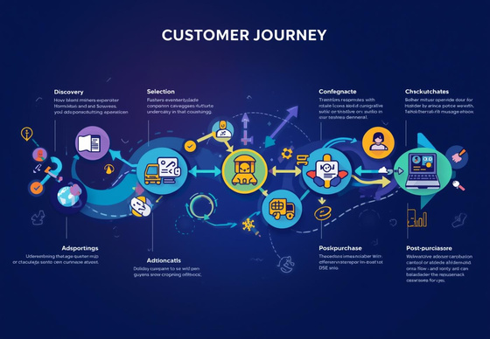


Customer Journey Map
User Discovery
Users typically begin their journey by discovering the PORTKEY platform through ads or recommendations online.
Visualizing User Experience
Application Browsing
The customer explores various restaurants and meal options, enhancing their experience with filters and search functions.
Order Checkout
Upon selecting items, users proceed to checkout, where secure payment options ensure a smooth transaction process.
NOTES & INSIGHTS
14

Slide 15

Technical Implementation
Exploring backend security and performance metrics.
NOTES FOR IMPLEMENTATION
15

Slide 16
Backend Security
Authentication
Cart Operations
Robust user authentication utilizes SHA-256 hashing for secure password storage, ensuring sensitive data remains protected during login and session management across the PORTKEY platform.
Efficient cart operations manage user sessions, allowing seamless item additions and removals while maintaining accurate price calculations and stock validations throughout the ordering process.
NOTES AND INSIGHTS
16

Slide 17
Payment Processing Ideas
Input Validation
Multi-Method Payments
Input validation ensures that user data is checked and sanitized, preventing malicious entries and enhancing security by minimizing potential vulnerabilities before processing any payment.
Multi-method payment processing allows users to select from various payment options, ensuring convenience and flexibility while adhering to PCI DSS compliance for secure transactions and digital receipts.
KEY TAKEAWAYS
17

Slide 18
< 3s
1000+
Average Page Load Time
Concurrent User Capacity
Users experience fast loading with under three seconds flat.
System efficiently handles over a thousand simultaneous users.
PERFORMANCE METRICS
18

Slide 19
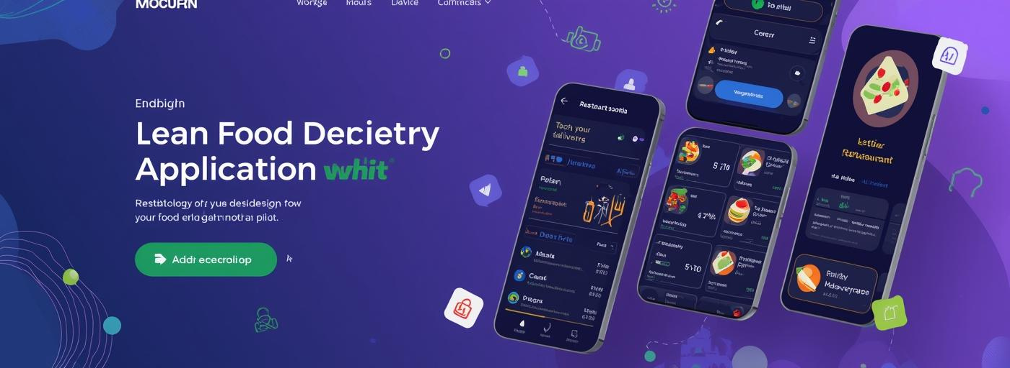
UI Design & Requirements
Focused on accessible, intuitive user experience design.
NOTES ON DESIGN
20

Slide 20
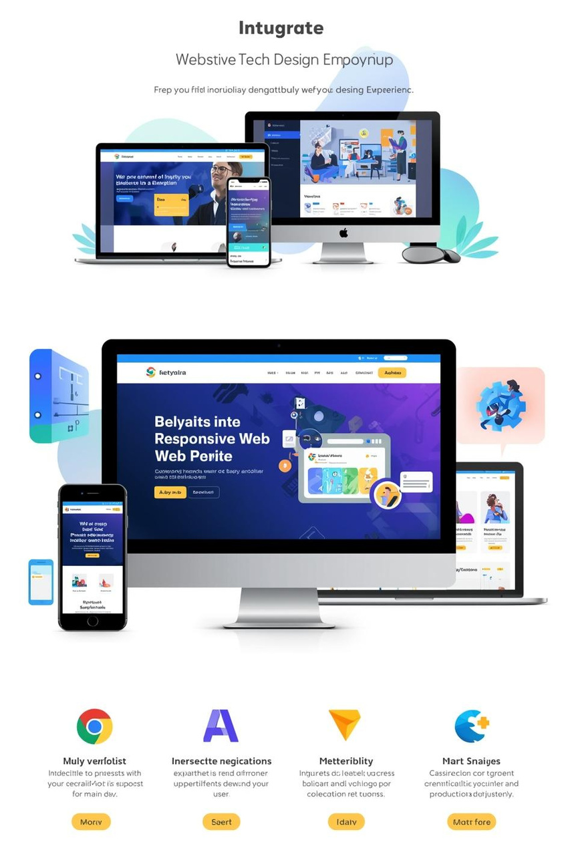

UI Design
Responsive, Accessible, and Intuitive Design Principles
DESIGN PRINCIPLES
21

Slide 21
Functional Requirements
User Module
Restaurant Module
Order Module
The User Module facilitates user registration, authentication, and profile management, providing a seamless experience for customers to create and manage their accounts within the PORTKEY platform.
The Restaurant Module enables users to browse, search, and filter through local restaurants, providing detailed menu information and recommendations to enhance the dining experience within the app.
The Order Module allows users to add items to their cart, validates stock availability, calculates total prices, and manages the order placement process for efficient food delivery.
Payment Module
Chatbot Module
The Payment Module supports multiple payment methods, ensures PCI DSS compliance, and issues digital receipts, creating a secure and convenient payment experience for users ordering food.
The Chatbot Module, AI-powered Hedwig, provides 24/7 support by assisting with orders, answering queries, and offering personalized recommendations based on user preferences and location.
PROJECT INSIGHTS
22

Slide 22
Non-Functional Requirements
Performance
Security
The system is designed to ensure optimal responsiveness, achieving page load times of less than three seconds, even under high traffic conditions, supporting over 1000 concurrent users seamlessly.
By implementing robust security measures, including SHA-256 hashing and session management, we maintain data integrity and protect user information against unauthorized access and potential breaches.
KEY CONSIDERATIONS
23

Slide 23
Development Practices
Requirements Engineering
MVC Design
Requirements engineering involves gathering, analyzing, and documenting functional and non-functional requirements, ensuring alignment with stakeholders’ needs and project goals for successful implementation.
The MVC design pattern promotes separation of concerns, allowing developers to manage application logic, user interface, and data efficiently, enhancing maintainability and scalability throughout the software lifecycle.
KEY PRACTICES
24

Slide 24
Challenges & Solutions
Real-Time Stock
Payment Integration
Implementing real-time stock updates required atomic database operations, ensuring accurate inventory levels. This minimizes order failures and enhances user confidence in product availability during peak demand.
Integrating multiple payment methods utilized an adapter pattern for seamless functionality. This approach ensured secure transactions while complying with PCI DSS standards, enhancing user trust and satisfaction.
KEY INSIGHTS
25

Slide 25
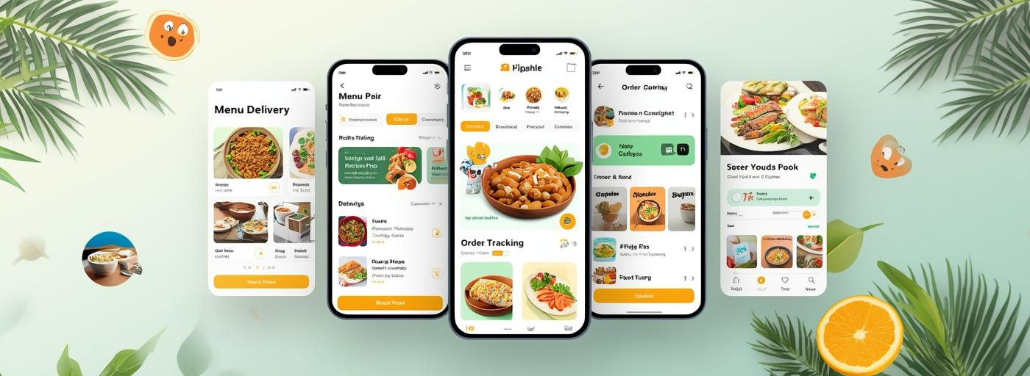
Future Enhancements
Planned features to improve user experience and functionality.
26

Slide 26
Future Enhancements
Mobile Apps
Developing mobile applications will enhance user accessibility and convenience, allowing customers to order food seamlessly from their smartphones, improving overall engagement and satisfaction with the PORTKEY system.
GPS Tracking
Integrating GPS tracking will provide real-time updates on order status and delivery locations, ensuring users can monitor their deliveries, enhancing transparency and trust in the service.
Advanced AI
Implementing advanced AI features will improve the customer experience by offering personalized recommendations, enhancing chatbot interactions, and streamlining operations through intelligent analytics and decision-making processes.
ADDITIONAL NOTES
27

Slide 27
Testing Strategies
Unit Testing
Integration Testing
Unit testing ensures that individual components of the PORTKEY application function correctly, allowing developers to identify and fix issues early in the development cycle, enhancing overall software quality.
Integration testing evaluates how different modules work together, ensuring seamless communication between the frontend, backend, and database, thus enhancing the reliability and performance of the PORTKEY system.
KEY INSIGHTS
28

Slide 28
Deployment Strategies
CI/CD Pipeline
Implementing a CI/CD pipeline facilitates continuous integration and deployment, allowing rapid updates. This ensures that new features are consistently tested and delivered to enhance user experience and system reliability.
TECHNICAL INSIGHTS
29

Slide 29

Standards and Team Dynamics
Collaborative efforts ensure project success and compliance standards.
NOTES AND INSIGHTS
30

Slide 30
Compliance Standards
IEEE 830-1998
This standard outlines requirements for software documentation, ensuring clear, consistent, and structured communication of requirements, enhancing project understanding and facilitating better development practices throughout the project lifecycle.
ISO/IEC 29148
ISO/IEC 29148 focuses on requirements engineering, providing guidelines for managing requirements throughout the software lifecycle, thereby improving overall quality, traceability, and stakeholder satisfaction in software projects.
W3C
W3C standards promote web accessibility and interoperability, ensuring that web technologies are developed with universal design principles, making applications usable by people with diverse abilities and across various platforms.
PCI DSS
PCI DSS establishes rigorous security measures for payment data, mandating that organizations handling credit card transactions enhance their security protocols, thereby protecting consumer information and reducing fraud risks.
ADDITIONAL STANDARDS
31

